Slide 1


Huazhong University of Science and Technology
The Department of Electronics and Information Engineering
Electronic Circuit Analysis and Design
Dr. Tianping Deng
Email: dengtp@hust.edu.cn

Slide 2
Contents
PART 1 SEMICONDUCTOR DEVICES AND BASIC APPLICATIONS
Chapter 1 Semiconductor Materials and Diodes
Chapter 2 Diode Circuits
Chapter 3 The Field-Effect Transistor
Chapter 4 Basic FET Amplifiers
Chapter 5 The Bipolar Junction Transistor
Chapter 6 Basic BJT Amplifiers
Chapter 7 Frequency Response
Chapter 8 Output Stages and Power Amplifiers
PART 2 ANALOG ELECTRONICS
Chapter 9 Ideal Operational Amplifiers and Op-Amp Circuits
Chapter 10 Integrated Circuit Biasing and Active Loads
Chapter 11 Differential and Multistage Amplifiers
Chapter 12 Feedback and Stability
Chapter 13 Operational Amplifier Circuits
Chapter 14 Nonideal Effects in Operational Amplifier Circuits
Chapter 15 Applications and Design of Integrated Circuits
Chapter 15 Applications and Design of Integrated Circuits

Slide 3
Chapter 15: Applications and Design of Integrated Circuits
15.0 Preview
15.1 Active Filters
15.2 Oscillators
15.3 Schmitt Trigger Circuits
15.4 Nonsinusoidal Oscillators and Timing Circuits
15.5 Integrated Circuit Power Amplifiers
15.6 Voltage Regulators
15.7 Summary

Slide 4
15.6 Voltage Regulators
15.6.1 Basic Regulator Description
15.6.2 Output Resistance and Load Regulation
15.6.3 Simple Series-Pass Regulator
15.6.4 Positive Voltage Regulator

Slide 5

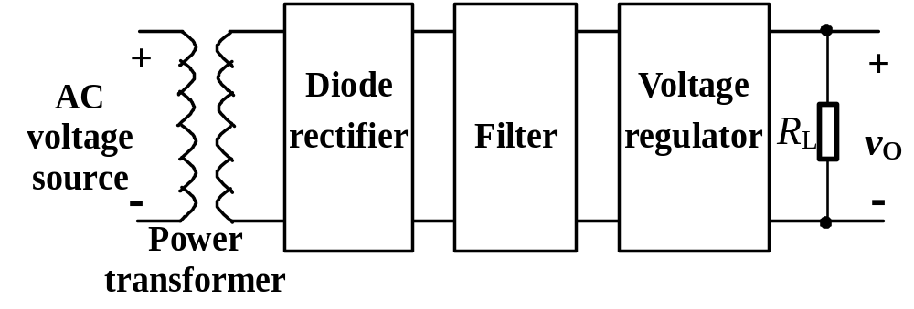
15.6.0 Review
Block diagram of an electronic power supply

Slide 6
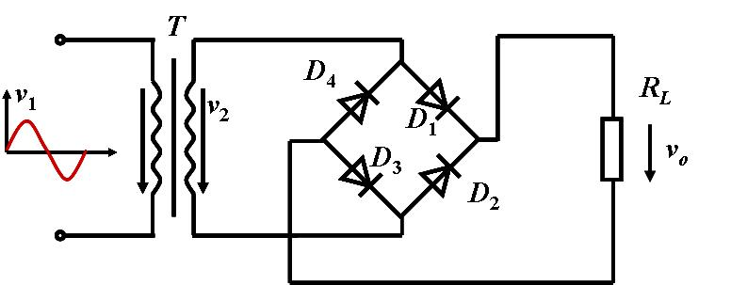
15.6.0 Review
v₂
ωt
0
π
2π
3π
4π
Not consider the forward voltage of the diode.
v_{L}

Slide 7
15.6.0 Review
V_{L}
The average value of V_{L}:
ωt
1
0
π
2π
2
π
(
)
V
=
∫
v
d
ω
t
L
2
π
0
L
1
π
(
)
1
π
(
)
V
=
∫
v
d
ω
t
=
∫
sinω t
d
ω
t
2
V
L
π
L
π
0
2
0
2
2
V
=
2
=
0
.
9
V
π
2
The average value of I_{L}:
I_{L}= V_{L} /R_{L} =0.9 V₂ / R_{L}

Slide 8
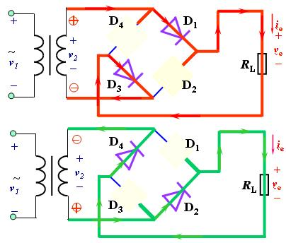


15.6.0 Review
The average value of I_{D}:

Slide 9
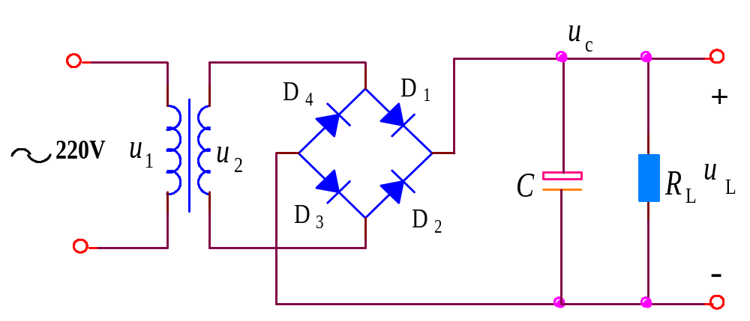

15.6.0 Review
u_{c}= u_{L}
u₂
t
i_{D}
if τ_{d} ≥（3 ∼ 5） ，
t
V_{L} = ( 1.1 ∼ 1.2 )V₂

Slide 10
Block diagram of an electronic power supply
Two question we must consider:
1）The input AC voltage will fluctuate, always ±10%.
2）The value of the load will change.

Slide 11
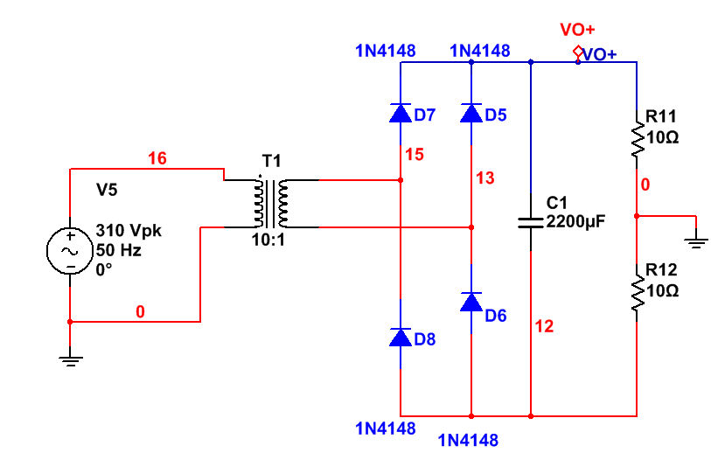
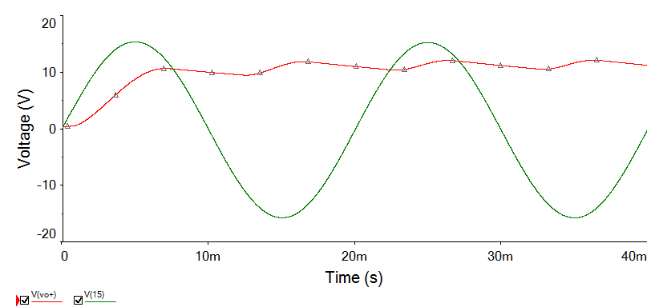
15.6.1. Basic Regulator Description

Slide 12
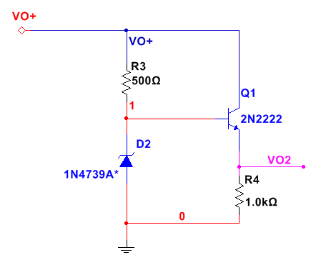
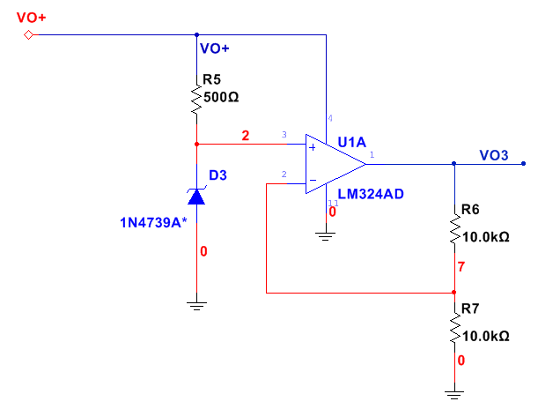
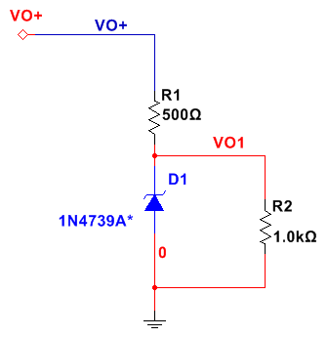
15.6.1. Basic Regulator Description
1）The output voltage is determined
by the Zener diode,cannot change easily;
1）you can run at lower Zener current,
and low quiescent disspation when unload.
2）The output voltage changes with Zener
current and input VO+;
2）The output voltage cannot change easily;
1）The zener current can be very small;
3）The Zener currenr must be large enough
so that at maximum load also works.
2）The output voltage can adjust easily;
4）To accommodate large load current, you
would need a high –power Zener diode.
3）The output current is limited by the
op-amp’s I_{out(max)}
5）When no load, also very large Zener
current.

Slide 13
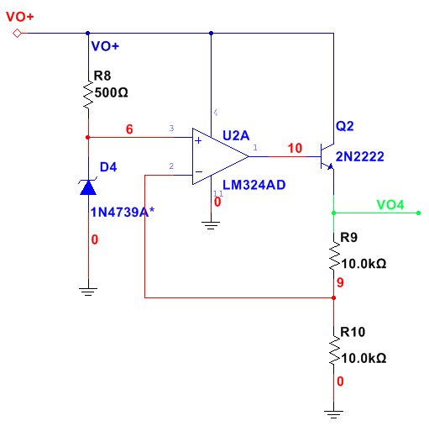
15.6.1. Basic Regulator Description

Slide 14
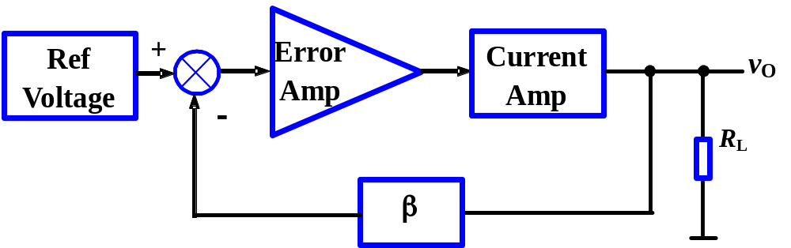
15.6.1. Basic Regulator Description
1. Block Diagram of a Voltage Regulator
Voltage regulator consists of four parts.

Slide 15
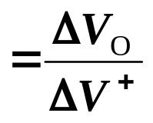
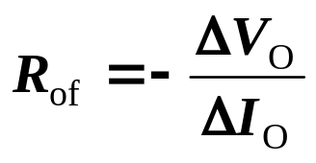
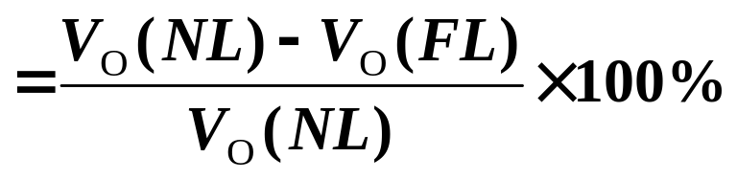
15.6.2 Output Resistance and Load Regulation
The figures of merit
Line regulation
V⁺ supply voltage
Output resistance
R_{of} is positive, negative sign means that I_{O}↑ produces V_{O}↓
Load regulation
V_{O}(NL) is zero-load, V_{O}(FL) is full-load

Slide 16
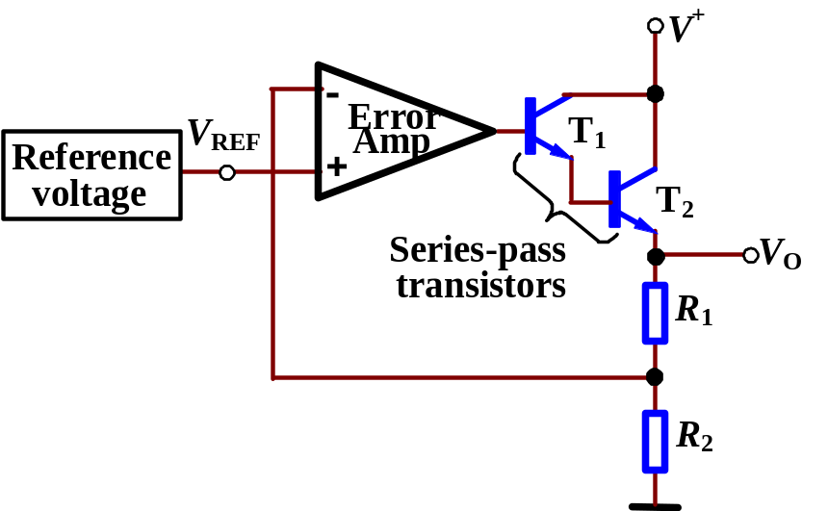
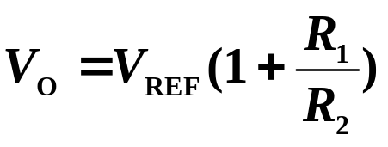
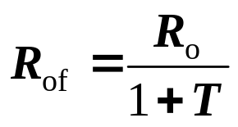
15.6.3 Simple Series-Pass Regulator
Error Amp is comparator
What configurations?
T₁ and T₂ are Darlington
Output feedback is a shunt connection, R_{of} becomes smaller, V_{o} becomes more stable.

Slide 17
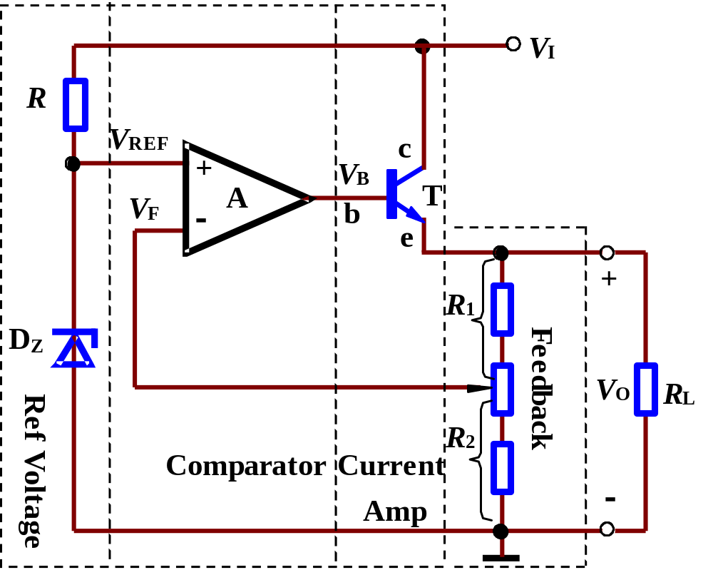
15.6.3 Simple Series-Pass Regulator
1. The Structure

Slide 18
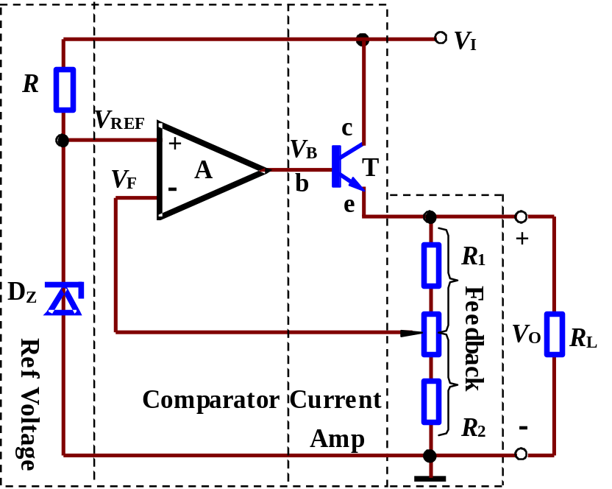
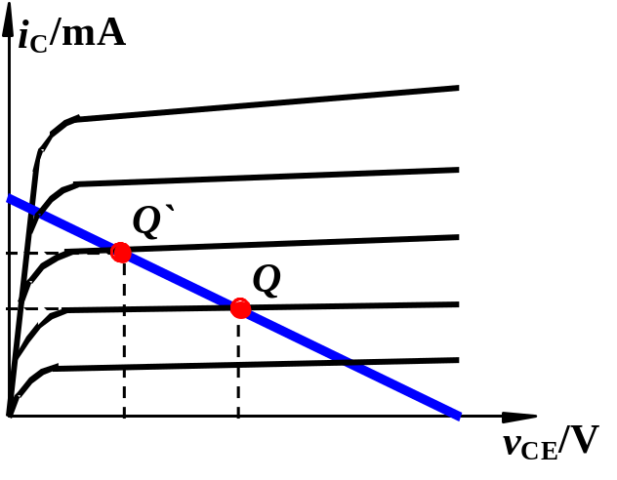








15.6.3 Simple Series-Pass Regulator
2. The Operating
Series-Shunt configuration
(+)
(+)
Change in v_{I}
(+)
Change in v_{O}
(+)
Change in I_{O}
Output Voltage

Slide 19
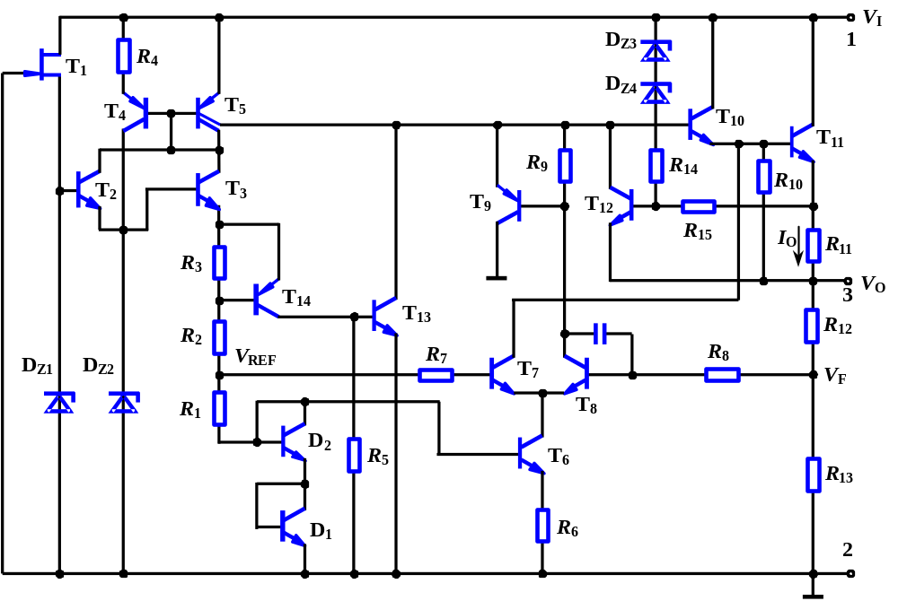
15.6.3 Integrated Three-Terminal Voltage Regulator
Current source
Current limiting
Current amp
1. Positive voltage regulator 78××
Startup
Feedback
Thermal protection
comparator
Ref Voltage

Slide 20
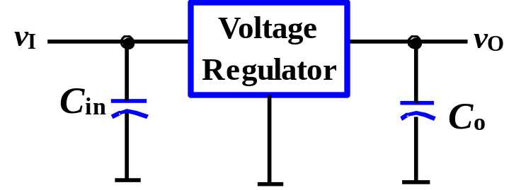
15.6.3 Integrated Three-Terminal Voltage Regulator
2. Application
a. Basic Application
C_{in} is compensating capacitor to
prevent high frequency noise.
3
C_{o} may improve the response
of the regulator.
2
1

Slide 21
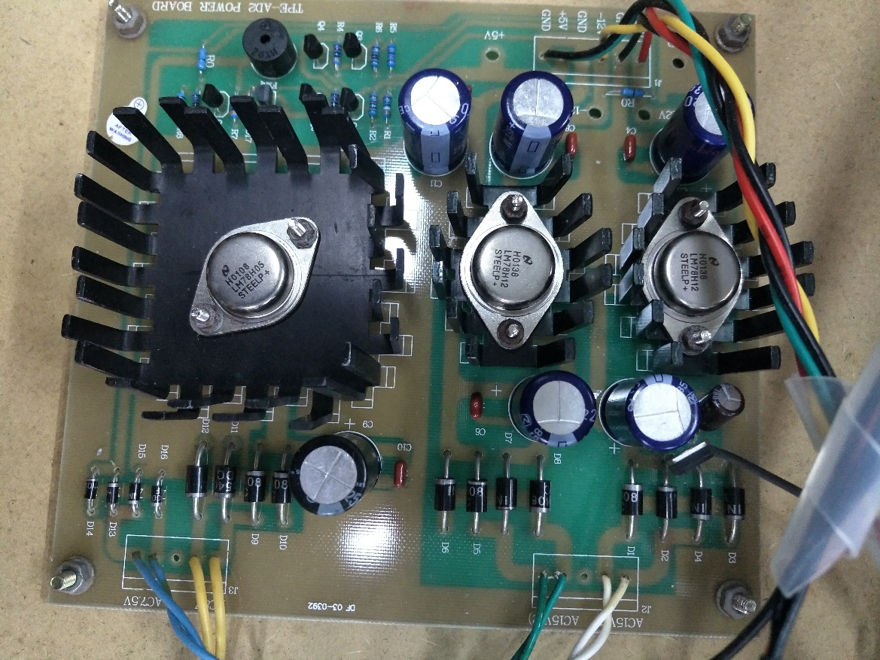
15.6.3 Integrated Three-Terminal Voltage Regulator
1
3
78LXX
+
_
+
_
2
V_{I}
C₁
C₂
V_{o}
0.1~1μF
1µF
7810(+10V), 7805(+5V)
7905(-5V), 7910(-10V)

Slide 22
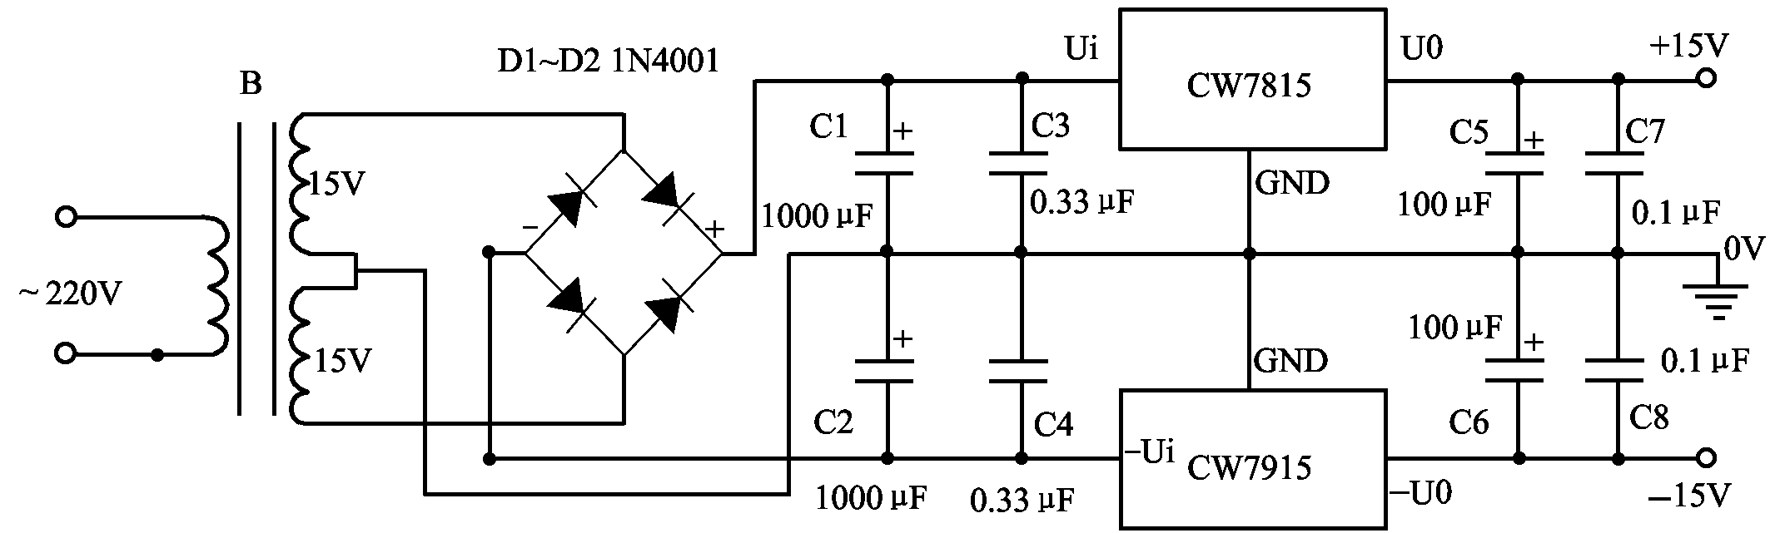
Application circuit:

Slide 23
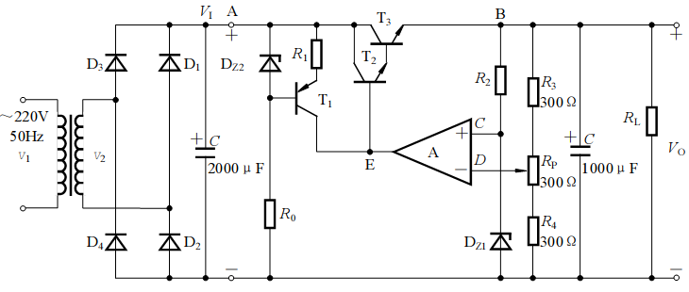
EXAMPLE 1
(1) The RMS value of the secondary of the transformer V₂=20V,
determine the value of V_{I}.
(2) explain the function of the T₁,R₁,D_{Z2};
(3) If the arrow in the middle and no load ,when V_{Z1}=6V,V_{REF}=0.7V,
calculate the value of V_{A}, V_{B}, V_{C}, V_{D},V_{E} and V_{CE3}.
(4) Determine the value range of the output voltage V_{O};
(5) when V_{O}=12V,R_{L}=150Ω, R₂=510 Ω, calculate the power consumption of P_{C3}.

Slide 24





EXAMPLE 1

Slide 25


EXAMPLE 1
(3) If the arrow in the middle and no load ,when V_{Z1}=6V,V_{REF}=0.7V,
calculate the value of V_{A}, V_{B}, V_{C}, V_{D},V_{E} and V_{CE3}.

Slide 26
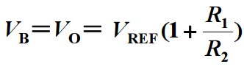
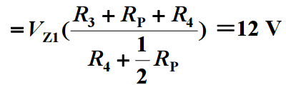





EXAMPLE 1

Slide 27
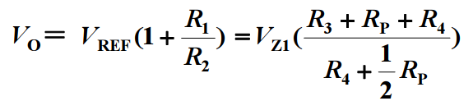
EXAMPLE 1

Slide 28
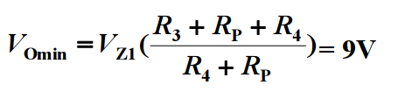
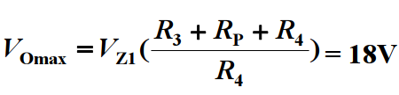
EXAMPLE 1

Slide 29




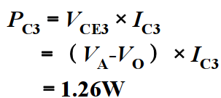

EXAMPLE 1

Slide 30
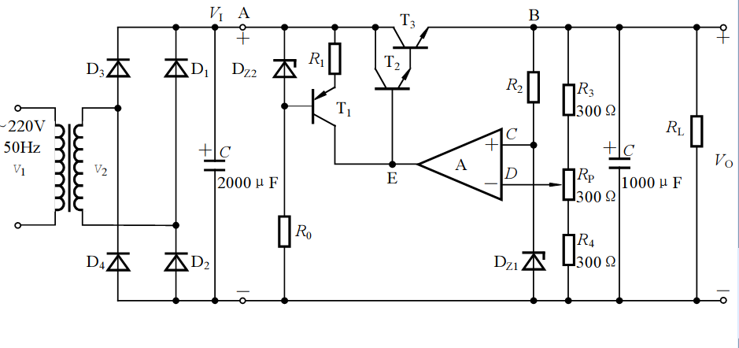
EXAMPLE 1

Slide 31
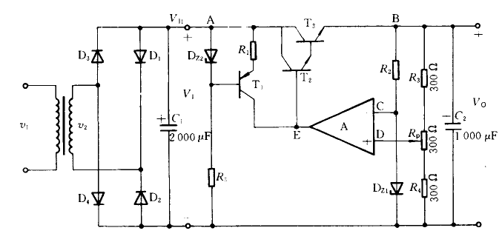
EXAMPLE 2
Find out the errors of the circuit.

Slide 32
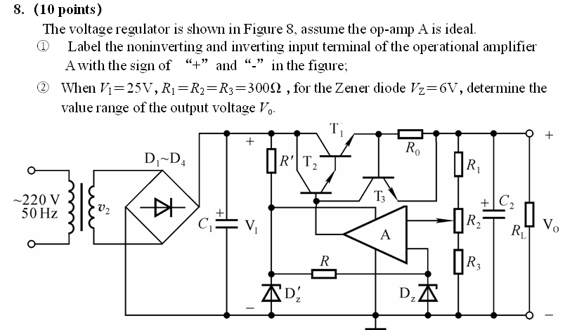

Slide 33
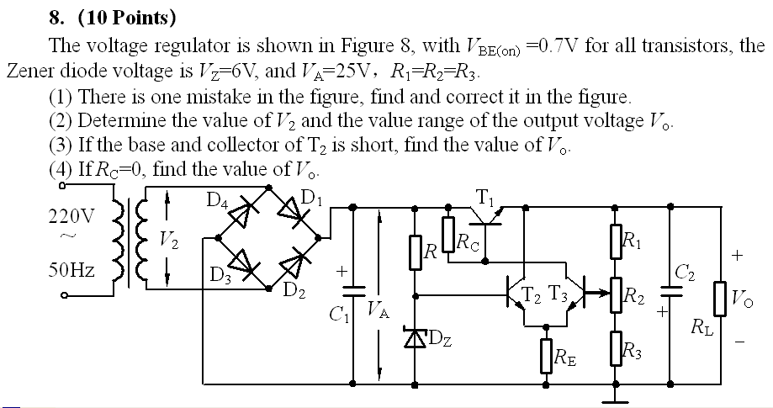

Slide 34
Questions
and
Answers

